Slide 1



Rockbuster Stealth LLC Launch Strategy
Presented By: Stephanie Burns, Data Analyst

Slide 2
Overview
Rockbuster Stealth LLC is a movie rental company that used to have stores around the world. Facing stiff competition from streaming services such as Netflix and Amazon Prime, the Rockbuster Stealth management team is planning to use its existing movie licenses to launch an online video rental service in order to stay competitive.
2

Slide 3
Key Questions
Which movies contributed the most/least to revenue gain?
What was the average rental duration for all videos?
Which countries are Rockbuster customers based in?
Where are customers with a high lifetime value based?
Do sales figures vary between geographic regions?
3

Slide 4
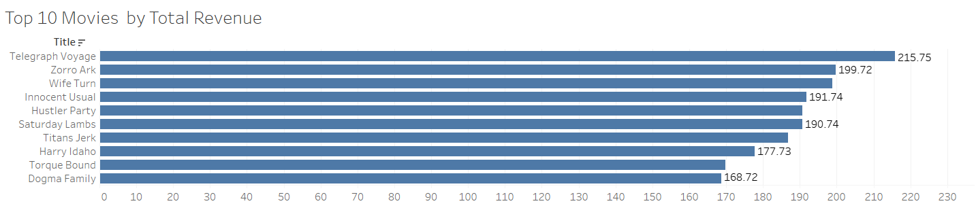
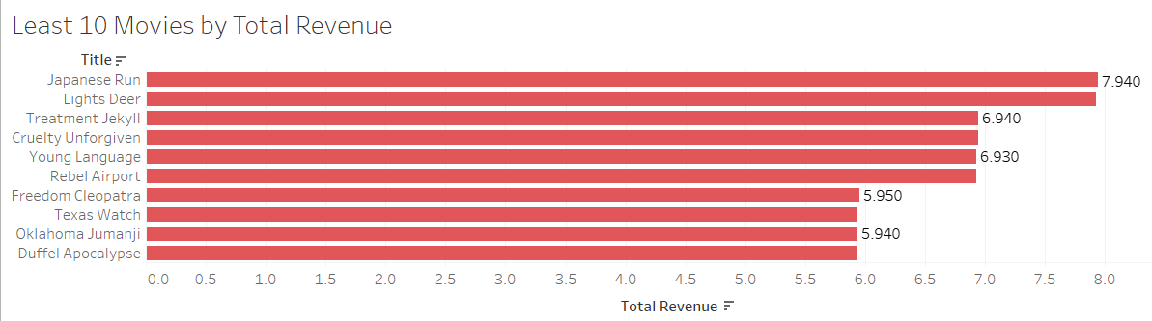
Which movies contributed the most/least to revenue gain?
4

Slide 5
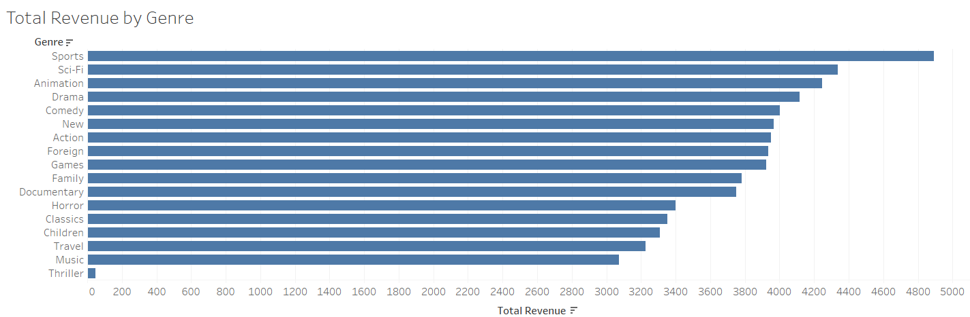
Which movies contributed the most/least to revenue gain? (cont.)
5

Slide 6
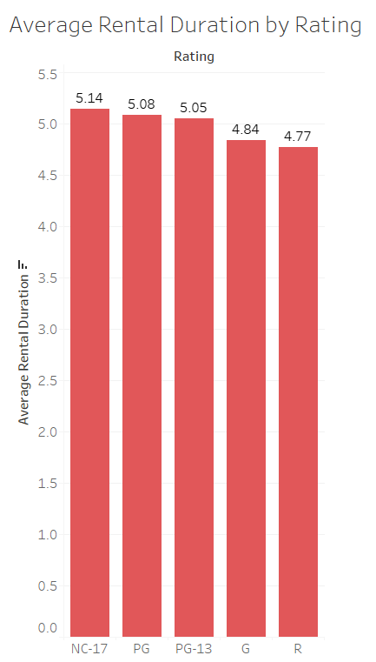
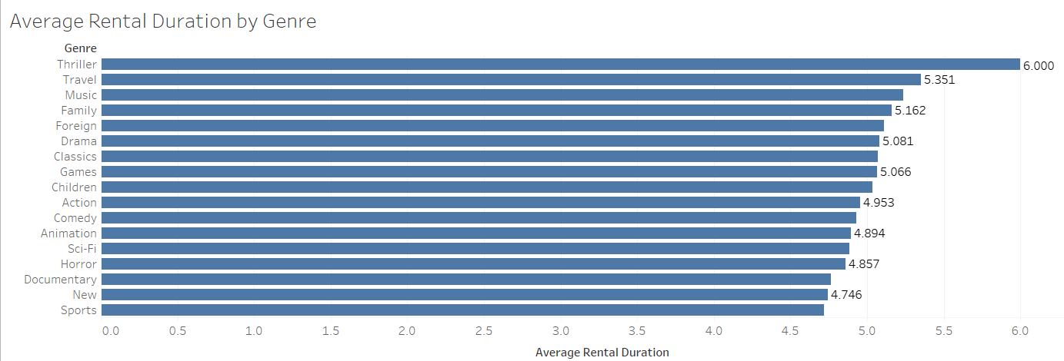
What was the average rental duration for all videos?
The average rental duration for all videos is about 5 days. Thrillers have the longest rental durations of all genres, and NC-17 has the longest rental durations of all ratings.
6

Slide 7
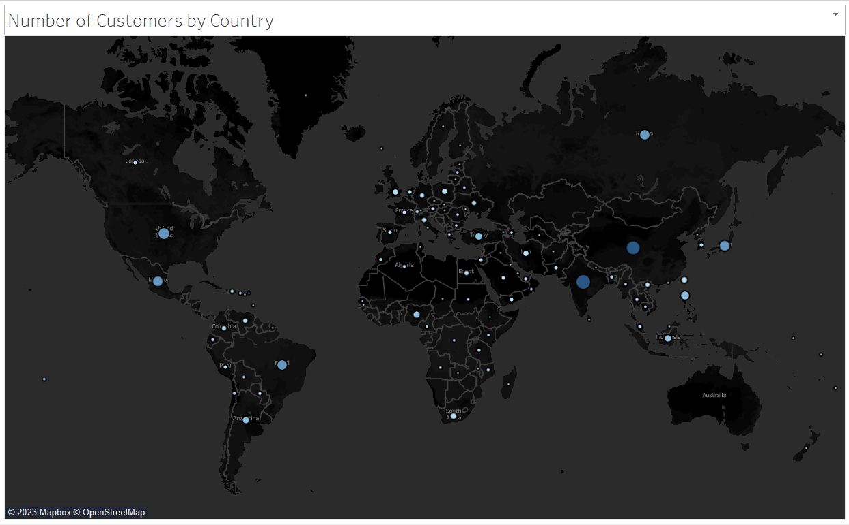
Which countries are Rockbuster customers based in?
Country | Number of Customers
India | 60
China | 53
United States | 36
Japan | 31
Mexico | 30
Brazil | 28
Russian Federation | 28
Philippines | 20
Turkey | 15
Indonesia | 14
7

Slide 8
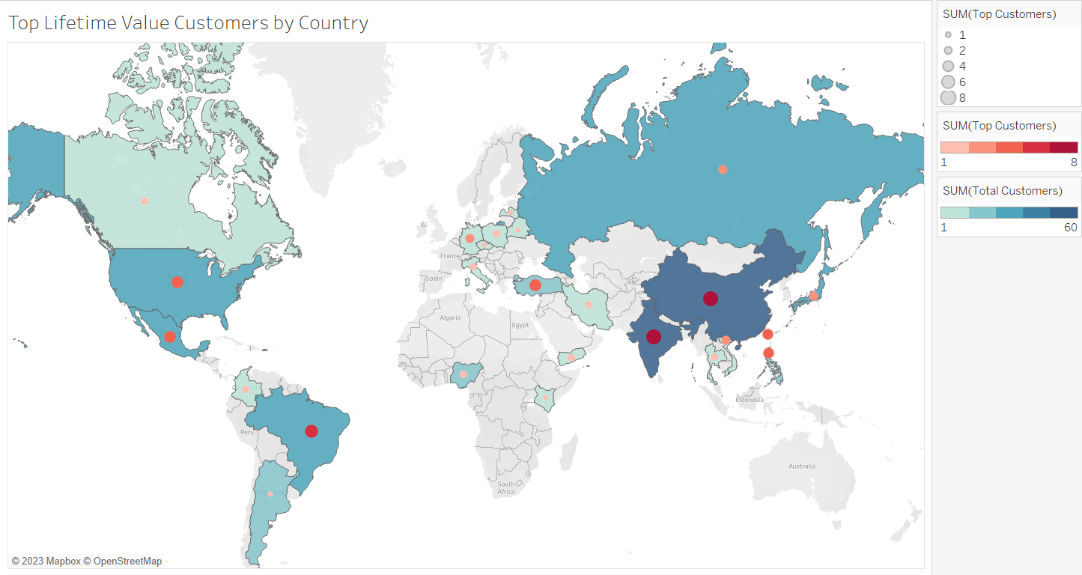
Where are customers with a high lifetime value based?
China and India have the highest numbers of total customers and top customers.
8

Slide 9
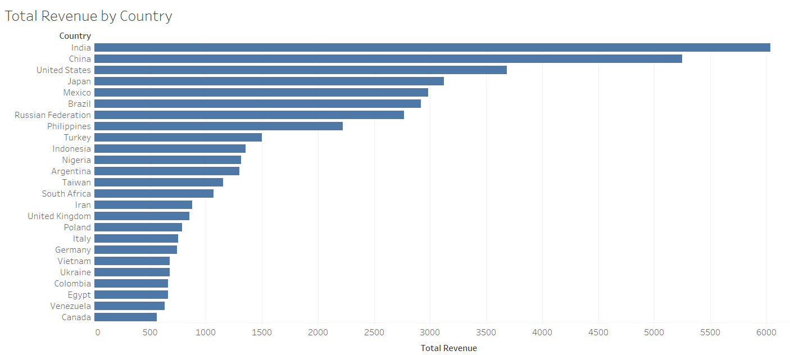
Do sales figures vary between geographic regions?
9

Slide 10

Summary
Sports genre contributed to the most revenue gain. Thriller genre contributed to the least revenue gain; however, even though Thriller movies brought in the least amount of revenue, they had the longest rental duration.
Average rental duration for all movies was five days.
India and China have the largest number of Rockbuster customers and the largest number of top customers.
10

Slide 11

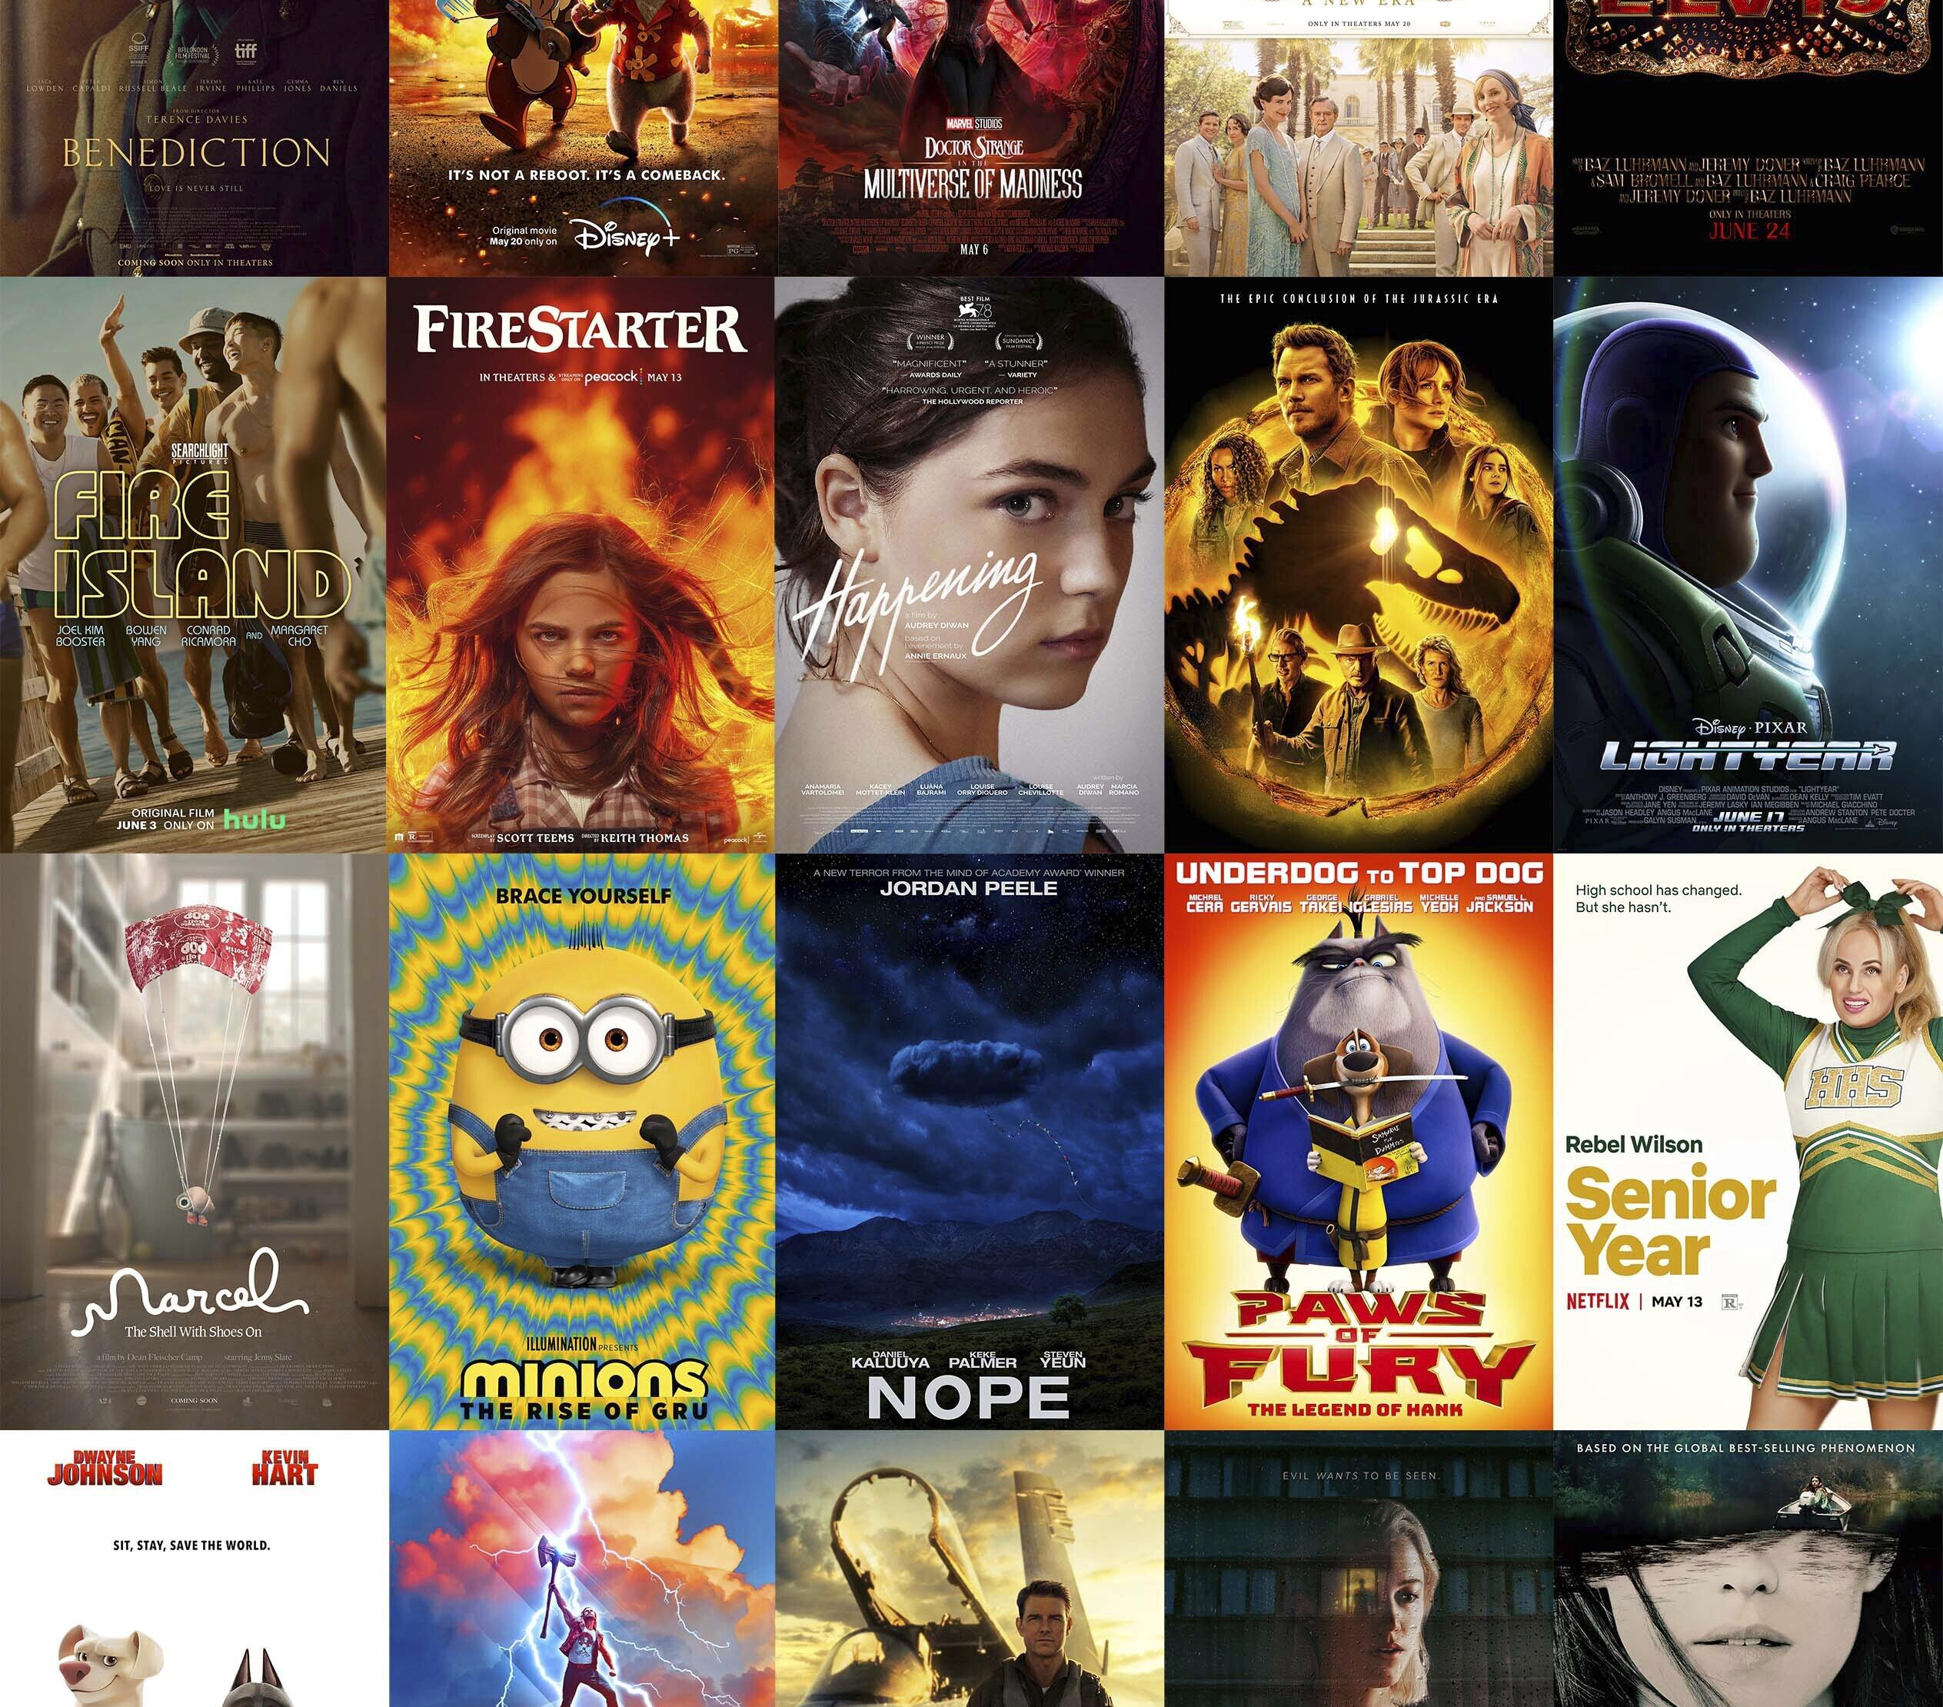


Thank you
Stephanie Burns
stephanie.m.burns13@gmail.com

Slide 12
Tableau Links
3.10 Revenue by Genre | Tableau Public
Avg Rental Duration | Tableau Public
Number of Customers by Country | Tableau Public
3.10 Top Lifetime Customers | Tableau Public
3.10 Sales by Country | Tableau Public
12

